Slide 1
ei_AIT1L_Packaging Instructions
Creator Name: Sanket Radde
Date: 2021/08/23

Slide 2
Bill of Material
Part names and Item numbers, we referring to in this document are mentioned in the below table.

Slide 3
Bill of Material

Slide 4
Bill of Material

Slide 5
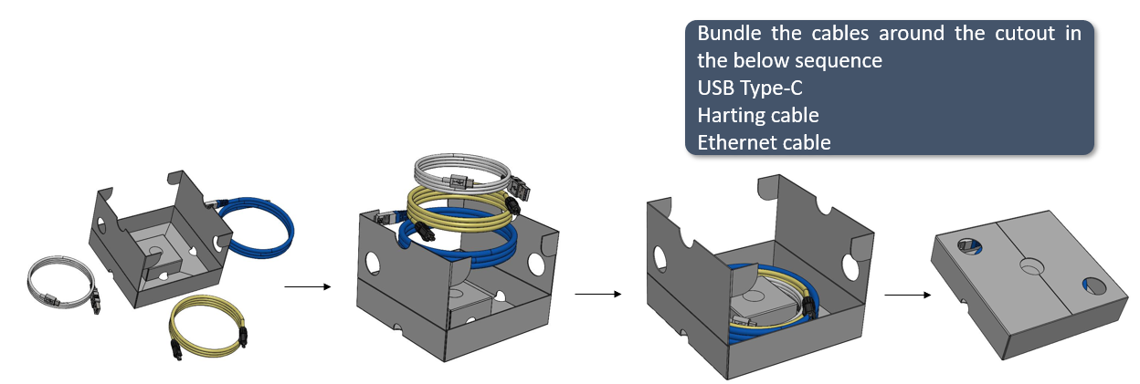
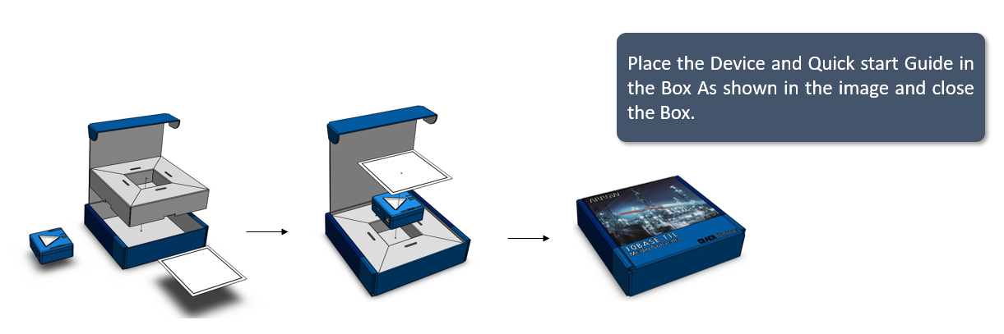
AIT1L_Packaging Instructions
1.
2.
3.
4.
5.
6.
7.

Slide 6


Slide 7
Thank You

